Slide 1

AOLME Curriculum Session 6
MATERIALS DEVELOPED BY THE AOLME PROJECT AT THE UNIVERSITY OF NEW MEXICO, PLEASE DO NOT COPY OR DISTRIBUTE ANY OF THESE COPYRIGHTED TASKS WITHOUT PROPER AUTHORIZATION

Slide 2


Level 1
SESSION 1: Basic of Raspberry PI and Linux-(motivational overview of projects-images, ls, cd, to find and play previous videos) SESSION 2: Introduction to Python (print, for, if) SESSION 3: Algorithms (for loops-arithmetic progressions, if statements-ranges, inequalities) SESSION 4: The Coordinate Plane and Black & White Images in Python SESSION 5: Binary and Hexadecimal number systems SESSION 6: Color Images and Their Components (histograms?) SESSION 7: Creation of Images and Video FINAL PROJECT: VIDEO

Slide 3
Images and their components
OBJECTIVES:
Represent grayscale and color images using RGB.
Manipulate real images (using a digital camera).
Open image files in Python and familiarize with AOLME Python Library.
Link image creation with binary and hexadecimal numbers.

Slide 4

Selected ACTIVITIES
1. Creating grayscale and color images using the “Binary Image Generator” (binary colors, open play)
Connecting color images with RGB Hex and decimal values
Processing Real images through the AOLME library by defining image Coordinates plane (coordinates, grouping, blocks, share and modify-’debug’), arrays, and ranges with python (debug, program, share and modify-DMI)

Slide 5
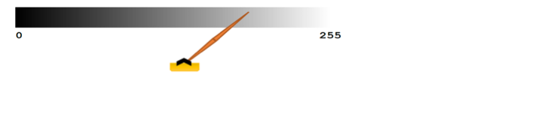
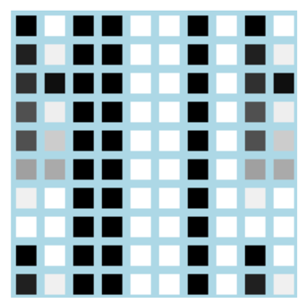
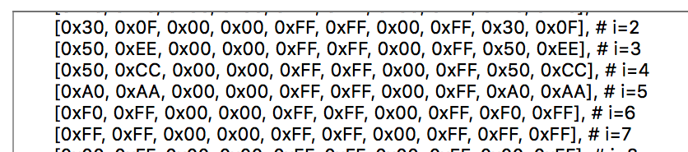

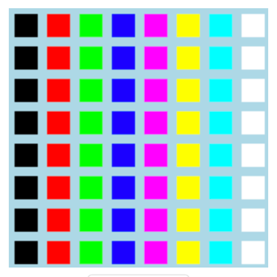
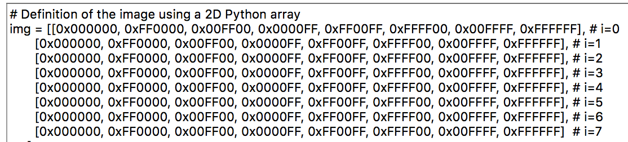
6.1. Creating Images w/ the “Image Generator”
What’s the value for your favorite color?
Have you ever mixed colors?
How is this process different from what you did before?
1. On your computer desktop, go to the WebApp folder open it, set grid size, and set it to: Grayscale.
Colors are developed through the combination of three color components: Red, Green, and Blue. The value (hex) given to each component determines the RGB combination and the final color.
Grayscale images have gray tones that go from white to black in values of 00-FF (hex numbers) or 0-255. Which value is the darkest?
What’s your favorite gray tone?
Why does this RGB value give you red?
“FF0000” = (255, 0, 0) = red
Set image generator in color, create 4-5 colors and talk about how each color is formed.
See how colors combine to create new ones.
In the columns ‘j’ enter 4-5 gray tones and talk about how each is formed.
Take turns writing the codes for all these colors.
3. Create a gray and a color image. After developing each image, scroll down to the Python code and find out how the images and code (RGB-hex values) are related.
4. Discuss & Write: How do you make and represent a color? How are gray tones and colors different? How are the color codes of the images related to the columns and rows in the coordinate plane?
Visit HTML color picker for more color code:
www.w3schools.com/colors/colors_picker.asp
What hex codes make white? Why?
What’s an array?
You can change the matrix sizes (e.g., 8x8, 10x10) in the image generator!
Experiment, create and write color names and codes to use in your video!!
AOLME PROJECT - LEVEL 1- SESSION 6- 2019
MATERIALS DEVELOPED BY THE AOLME PROJECT AT THE UNIVERSITY OF NEW MEXICO, PLEASE DO NOT COPY OR DISTRIBUTE ANY OF THESE COPYRIGHTED TASKS WITHOUT PROPER AUTHORIZATION
Notes:
Reduce number of codes P
Provide examples of images and how they were pixelated

Slide 6
6.1. Creating Images w/ the “Image Generator”
Resources for the Activity
Recommended Steps for the Activity
Make sure the “Image Generator” online is set in grayscale or color and highlight the choice students have to set up the ‘size’ of the matrix.
Have students think about what colors need to be combined to create a color; for example, white, magenta, or cyan.
Motivate students to identify colors they like and come up with hex RGB codes for that color.
Let students have fun creating images.
Have students debrief what they learned by experimenting with the image generator and take notes in student journal.
Activity Card
Folder: /pi/AOLME/Session 4/
The “Image Generator” software
Raspberry Pi and Monitor
Student journal
Activity 1 Goal: Analyze and create grayscale and color images using the “Binary Image Generator” (binary colors, open play)
AOLME PROJECT - LEVEL 1- SESSION 6- 2018
MATERIALS DEVELOPED BY THE AOLME PROJECT AT THE UNIVERSITY OF NEW MEXICO, PLEASE DO NOT COPY OR DISTRIBUTE ANY OF THESE COPYRIGHTED TASKS WITHOUT PROPER AUTHORIZATION
Notes:
Reduce number of codes P
Provide examples of images and how they were pixelated

Slide 7
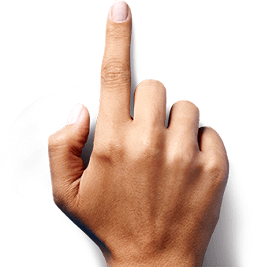
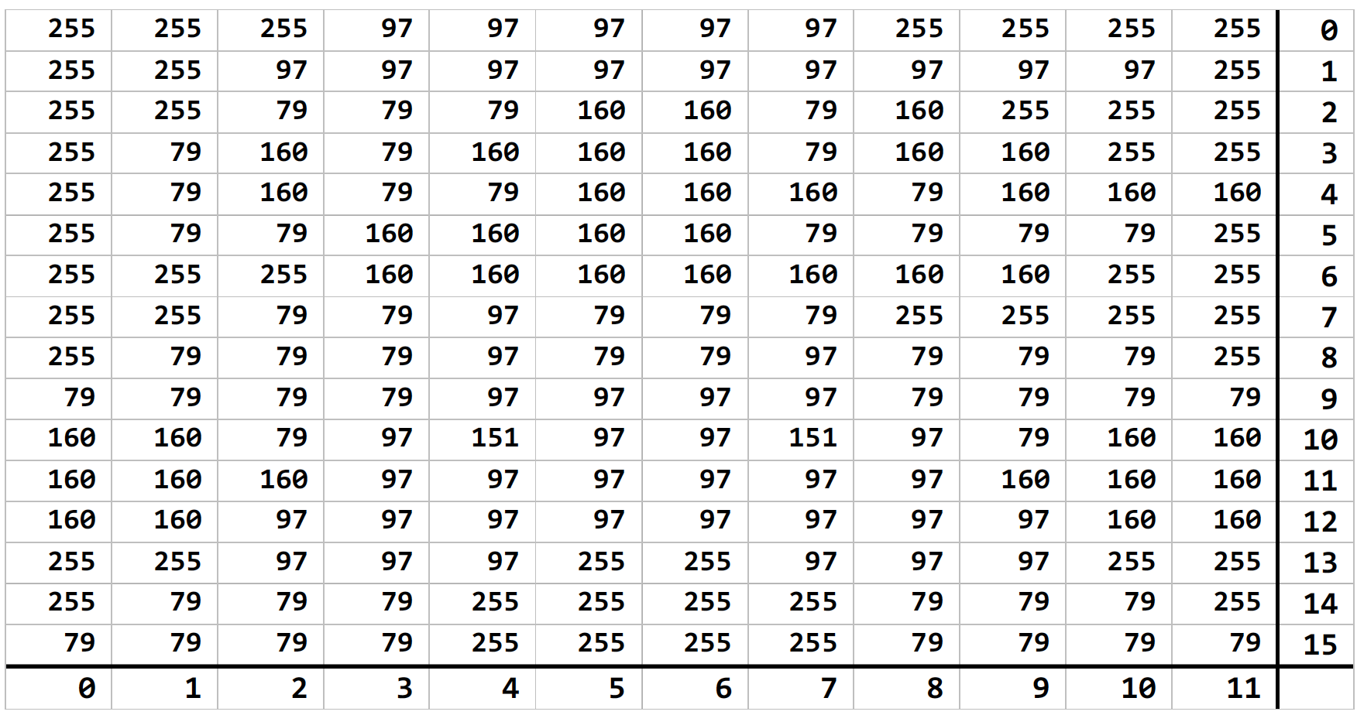
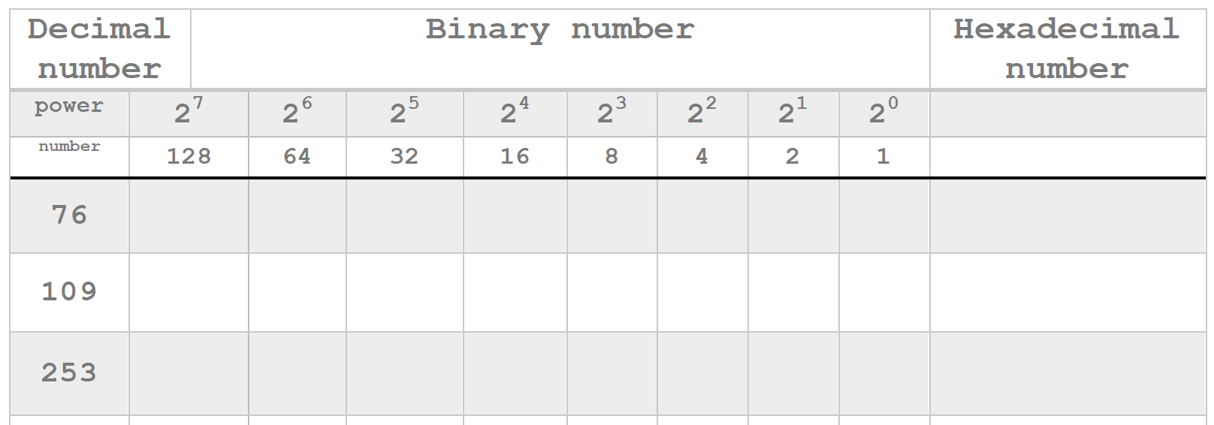
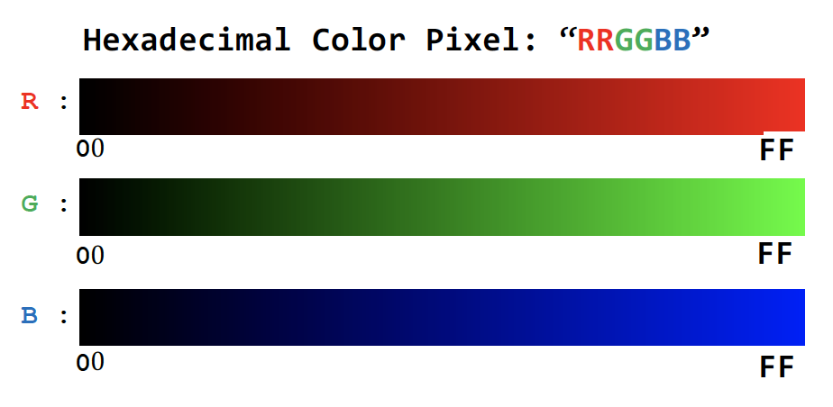


6.2. Images & Numbers
How is coordinate or matrix of codes linked to Mario’s image and color? What does a 97 mean?
What would subpixels for grayscale images look like?
2. Computers read image colors using hex #s. See how each pixel in Mario’s image has a value.
1. Look closely at the ‘sample’ image, see how each letter is created by pixels and each pixel is composed of smaller subpixels. The subpixels have color components that can be adjusted to make a color. Full RGB values make white. Why?
3. Why are hex numbers (not binary) used in Python code? Taking turns, choose 3 numbers in Mario’s matrix and convert them into binary & hexadecimal #s.
What colors do hex codes on the left represent? Why?
4. Write: In a grayscale you enter only one hex # per gray tone. Why do you think you need 3 hex #s to program a color? Take turns, imagining 3 hex codes and predict what colors they will make.
I think 76 is 1001100₂ and 4C₁₆
RGB = ________
RGB = ________
RGB =
AOLME PROJECT - LEVEL 1- SESSION 6- 2019
MATERIALS DEVELOPED BY THE AOLME PROJECT AT THE UNIVERSITY OF NEW MEXICO, PLEASE DO NOT COPY OR DISTRIBUTE ANY OF THESE COPYRIGHTED TASKS WITHOUT PROPER AUTHORIZATION
Notes:
Reduce number of codes P
Provide examples of images and how they were pixelated

Slide 8
6.2. Images & Numbers
Resources for the Activity
Recommended Steps for the Activity
Activity Card
Use the Raspberry Pi, go to folder: /pi/AOLME/Session 4/ Open the “Image Generator” and set it to ‘Grayscale’
Raspberry Pi and Monitor
Student journal
Identify that RGB works at the pixel level and it can be changed.
Highlight how a grayscale pic is only one frame, but color pics include three frames, RGB, in different tones each frame, like the Mario illustration.
Practice binary and hex numbers connected to colors. If needed, use materials from Session 5. Numbers could be corroborated through Python.
Have students debrief what they learned by experimenting and take notes of that on journal.
Activity 6.1 was to think about the components or colors to be combined to create another color, but this activity is to think about the RGB numerical values associated to that color combination to create new colors.
Activity 2 Goal: Explore how Hex and decimal values are linked to pixel RGB values in color /grayscale images
AOLME PROJECT - LEVEL 1- SESSION 6- 2018
MATERIALS DEVELOPED BY THE AOLME PROJECT AT THE UNIVERSITY OF NEW MEXICO, PLEASE DO NOT COPY OR DISTRIBUTE ANY OF THESE COPYRIGHTED TASKS WITHOUT PROPER AUTHORIZATION
Notes:
Reduce number of codes P
Provide examples of images and how they were pixelated

Slide 9
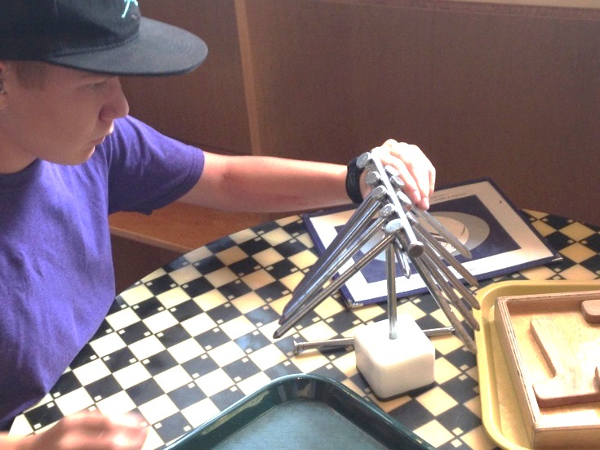
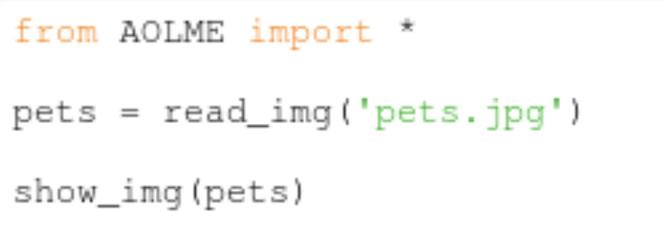
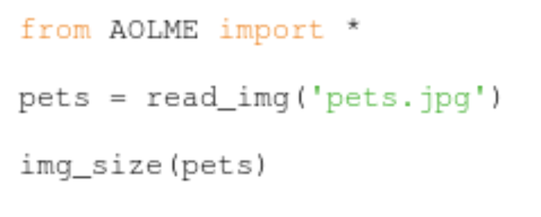
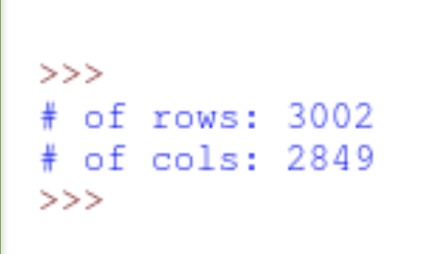
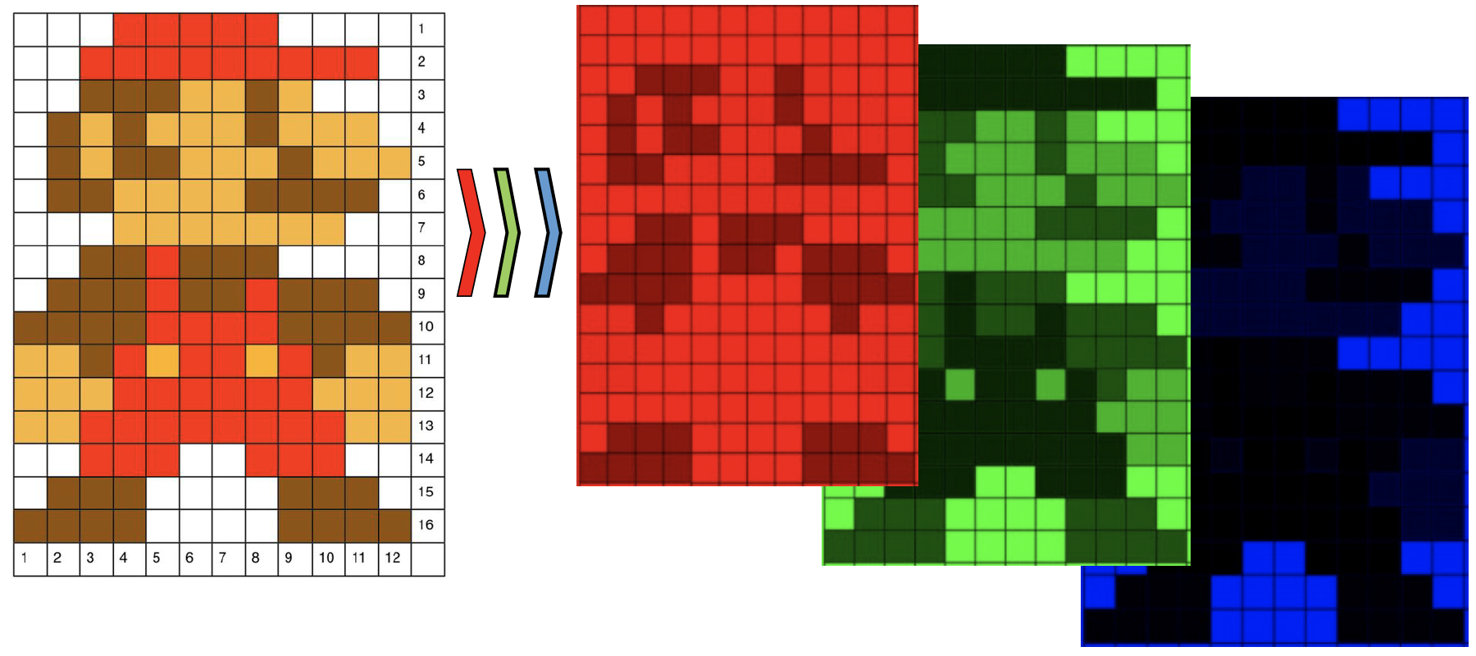
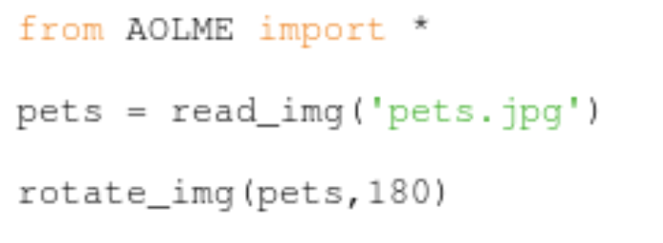
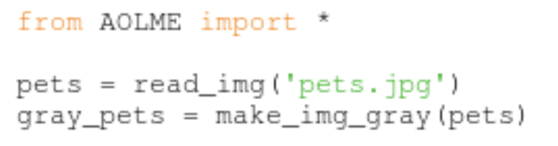
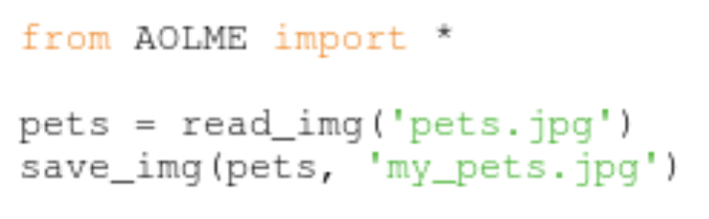
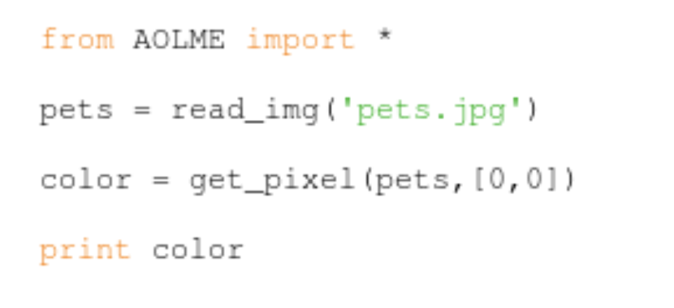
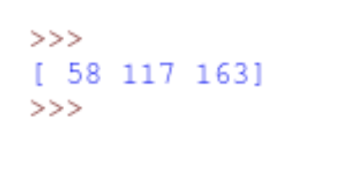
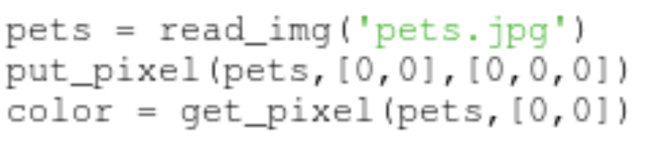
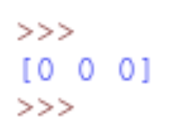
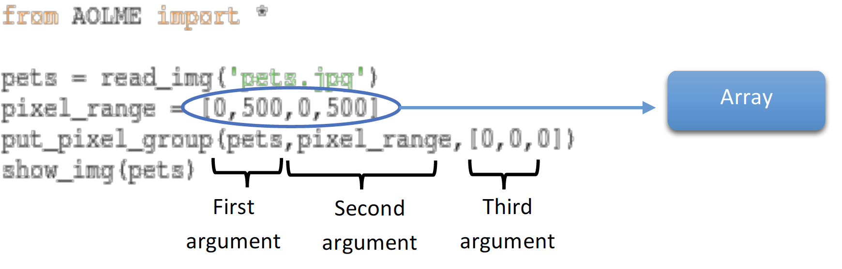
Take turns typing and running the code and discussing line-by-line what the code does.
6.3. Processing Real-life Images with Python
Functions processes inputs that are in parentheses, like print(180).
Note: Processing images = working with images
(a)
Take a group picture of your team and upload it onto the folder with AOLME.py. Name the image file with a short name related to your team! Open IDLE and open head.py. To run the program click on play or hit the f5 key. When done, save and name your file.
2. As a team, look for the functions and predict what they do. In the functions that use the name ’pets’, replace instead with the name of your image file. Write what you find out. Test the 6 options!!!
The RGB components determine the colors in your image.
(b)
response
(c)
(d)
(f)
(e)
Play with the # of degrees.
3. Let’s process & change images.
4. As team, take a flashdrive and borrow a picture from another team and come up with ideas to design and process that image. When done, share it with the team you got the picture from. Take turns typing in the code. Save all the work that you do!
Code for changes at the pixel level
Position: Row-column
How are arrays & positions related?
How’d you change the RGB values?
RGB
Code to change pixel_range.
Arguments are the input or variables (data) in a function.
AOLME PROJECT - LEVEL 1- SESSION 6- 2019
MATERIALS DEVELOPED BY THE AOLME PROJECT AT THE UNIVERSITY OF NEW MEXICO, PLEASE DO NOT COPY OR DISTRIBUTE ANY OF THESE COPYRIGHTED TASKS WITHOUT PROPER AUTHORIZATION
Notes:
Reduce number of codes P
Provide examples of images and how they were pixelated

Slide 10
6.3. Processing Real-life Images with Python
Resources for the Activity
Recommended Steps for the Activity
Activity Card
Digital Camera per group
USB drive per group
AOLME.py folder
Raspberry Pi and Monitor
Student journal
Let the team take initiative to decide where to take the picture.
Make sure name of the image is remembered by the group and saved onto both AOLME.py folder and onto the USB to share with another group.
In point 2, let students focus on the code syntax and meaning by experimenting and inferring what happens with each code.
Have them take notes on journal on what they discover.
In 2d emphasize the use of degrees, have them recall what they know and make connections.
In point 3, make sure that the teams change picture and are able to name and use arrays, ranges, and arguments. And that RGB components are changed.
Be creative and funny in point 4.
Activity 3 Goal: Process real-life images through the AOLME library by defining image Coordinates plane (coordinates, grouping, blocks, share and modify-’debug’), arrays, and ranges with Python (debug, program, share and modify-DMI)
AOLME PROJECT - LEVEL 1- SESSION 6- 2018
MATERIALS DEVELOPED BY THE AOLME PROJECT AT THE UNIVERSITY OF NEW MEXICO, PLEASE DO NOT COPY OR DISTRIBUTE ANY OF THESE COPYRIGHTED TASKS WITHOUT PROPER AUTHORIZATION
Notes:
Reduce number of codes P
Provide examples of images and how they were pixelated

